Slide 1
Cryptocurrency exchange
Requirements & Design

Slide 2

Presentation plan
Business context
User stories
Architecture
Implementation list

Slide 3

Business task
Exchange one currency for another
Get fee for every deal
Provide more services for more deals

Slide 4
User stories
User can sign up -> notify
User can deposit in any currency -> notify
User can create order -> order will be executed
User can see history action
User can get notifications

Slide 5
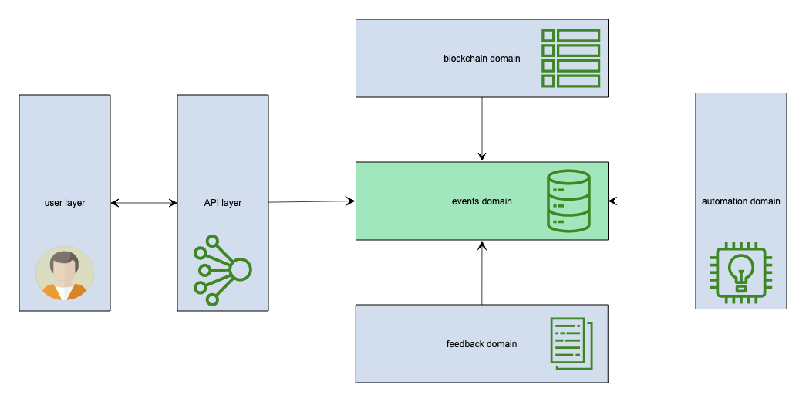
High level system arch

Slide 6
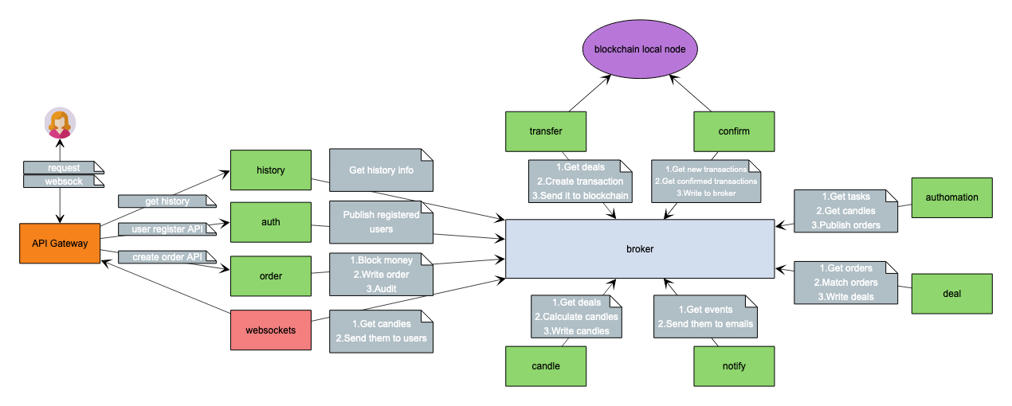
System layer arch

Slide 7
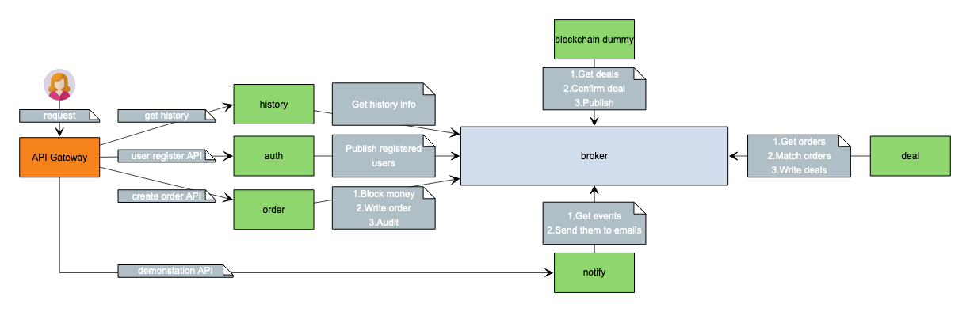
Implementation
Mockups
Services
Grafana dashboards
Demo via postman tests

